Slide 1
ONLINE MEDICAL CONSULTANT SYSTEM
GROUP 2

Slide 2
About us
Supervisor:
NGUYỄN HUY HÙNG
Team Member
TRẦN NGUYÊN TIẾN SỨ
TRẦN CAO DANH

Slide 3
Agenda
Introduction
List of changes
Demo
Q&A

Slide 4
Introduction

Slide 5


New features
Capture webcam
Enable private mode
View treatment history
Map conversation
Doctor
View treatment history
Patient

Slide 6
Demo
Doctor view treatment history
Doctor create new treatment
Doctor capture webcam from patient

Slide 7
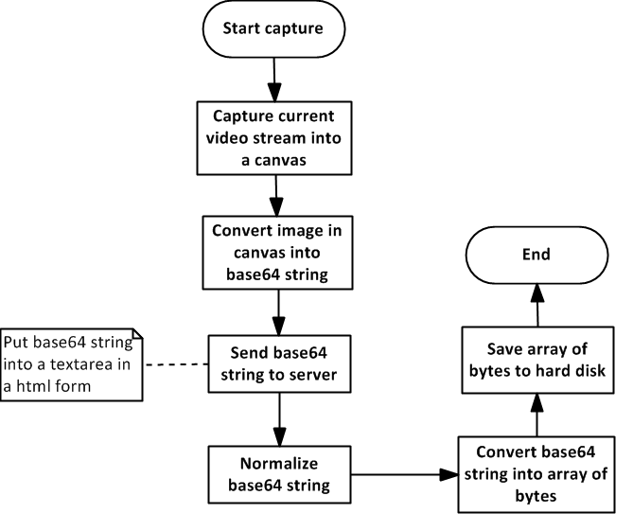
Capture webcam

Slide 8
Q&A

